Slide 1
From the Stall
In Search of Privacy
Kyle Fisher, Eden Prairie Schools
Troy Miller, LHB
Amy Satterfield, IEA

Slide 2
Privacy: Why All the Concern?
Different Times/Generations
Each Introducing Different Expectations/Norms
Those of Us Age 55 and Above
Those of Us Age 40 to 55
Those of Us Age 30 to 40
Those of Us Age 30 and Below

Slide 3
Privacy: Why All the Concern?
Different Times: Different Expectations
Title Nine: New Opportunities and New Challenges
Showering Expectations: Physical Education/Activities
Main Streaming Special Education Students
Greater Awareness of LGBTI Individual Needs
Social, Ethnic and Religious Norms
Allergies, Diabetes, and other Aliments
Toileting: Habits and Needs
Bullying and Abduction

Slide 4
Disclaimer
We are not:
Phycologists, Doctors, Lawyers, Sociologists
We are:
A School District Facility Director
An Environmental Consultant
An Architect
And We Are Parents

Slide 5
The Processes Leading to Change?
For Example:
Starts with a need or injustice
the reaction evolves organically
Guidelines and Procedures
an outcome from experiences and other intuitional information
Laws and Codes
an outcome due to lack acknowledgment or uniformity
Health Insurance Portability and Accountability Act
a 1996 Federal law that restricts access to individuals’ private medical information.

Slide 6
Women are Used to a Higher Degree of Privacy
Toilet Facilities
in America, individual stalls have nearly always been the norm
Showers in Locker Rooms
in America, individual stalls and/or rooms
Pool Facilities
always have swum with a swimsuit
Today, Lactation Rooms
are private, secure, and clean spaces
Expectations are Continuing to Evolve the
Private Space Trend
Growth or Greater Availability of the Family Restroom
an expectation of not just parents, but also kids and young adults

Slide 7
Men Were Use to Idea of Group or It Was the Social Norm
Toilet Facilities
Trough Urinals – Individual Urinals – Urinals with Partitions
Individual Toilet Stalls
Locker Rooms
Gang Showers
Group Dressing Areas
Pool Facilities
Swam naked - Added the “Issued” Swimsuit - Board Shorts
Expectations are Continuing to Evolve the
Private Space Trend
Growth or Greater Availability of the Family Restroom
an outcome from experiences and other intuitional information

Slide 8
We are Now Recognizing the Needs for Changing Norms
Family Restrooms
the comfort of and expectation for keeping personal/private
age differences and the identified “Normal”
gender and physical differences
medial reasons: medications, diapering, and etc.
Locker Rooms
private spaces for not just showering but disrobing for may of the same reasons
Free Zones
spaces reserved for those with allergies
Quite Space
a private personal space for feeling safe or secure
migraine headaches or other heath related concerns
de-escalation and the quite space for calming

Slide 9
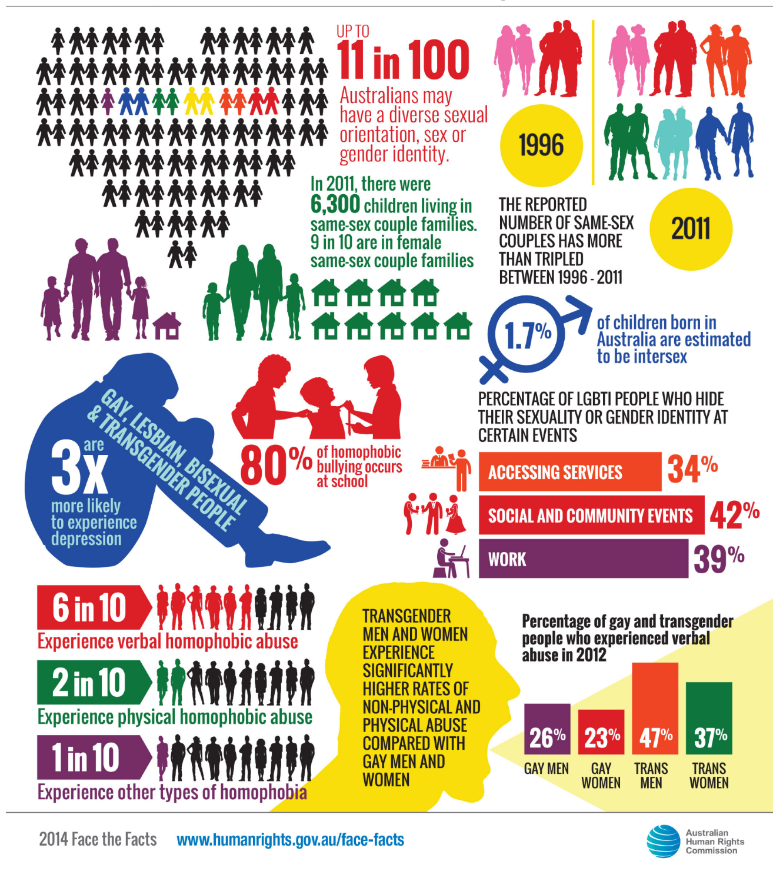
The Growing Understanding of Who We Are
New Social Norms
New Diagnosis
New Visibility
New Realities
We Now are Learning About the Term Intersex; people are born with sex characteristics (including genitals, gonads and chromosome patterns) that do not fit typical binary notions of male or female bodies. Intersex is an umbrella term used to describe a wide range of natural bodily variations

Slide 10
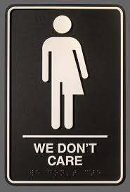
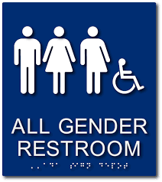
What are Some Outcomes of the New Social Norms
Toilet Facilities
a dramatic increase in the number of unisex restroom
Remember the Costs to Operations and Maintenance

Slide 11
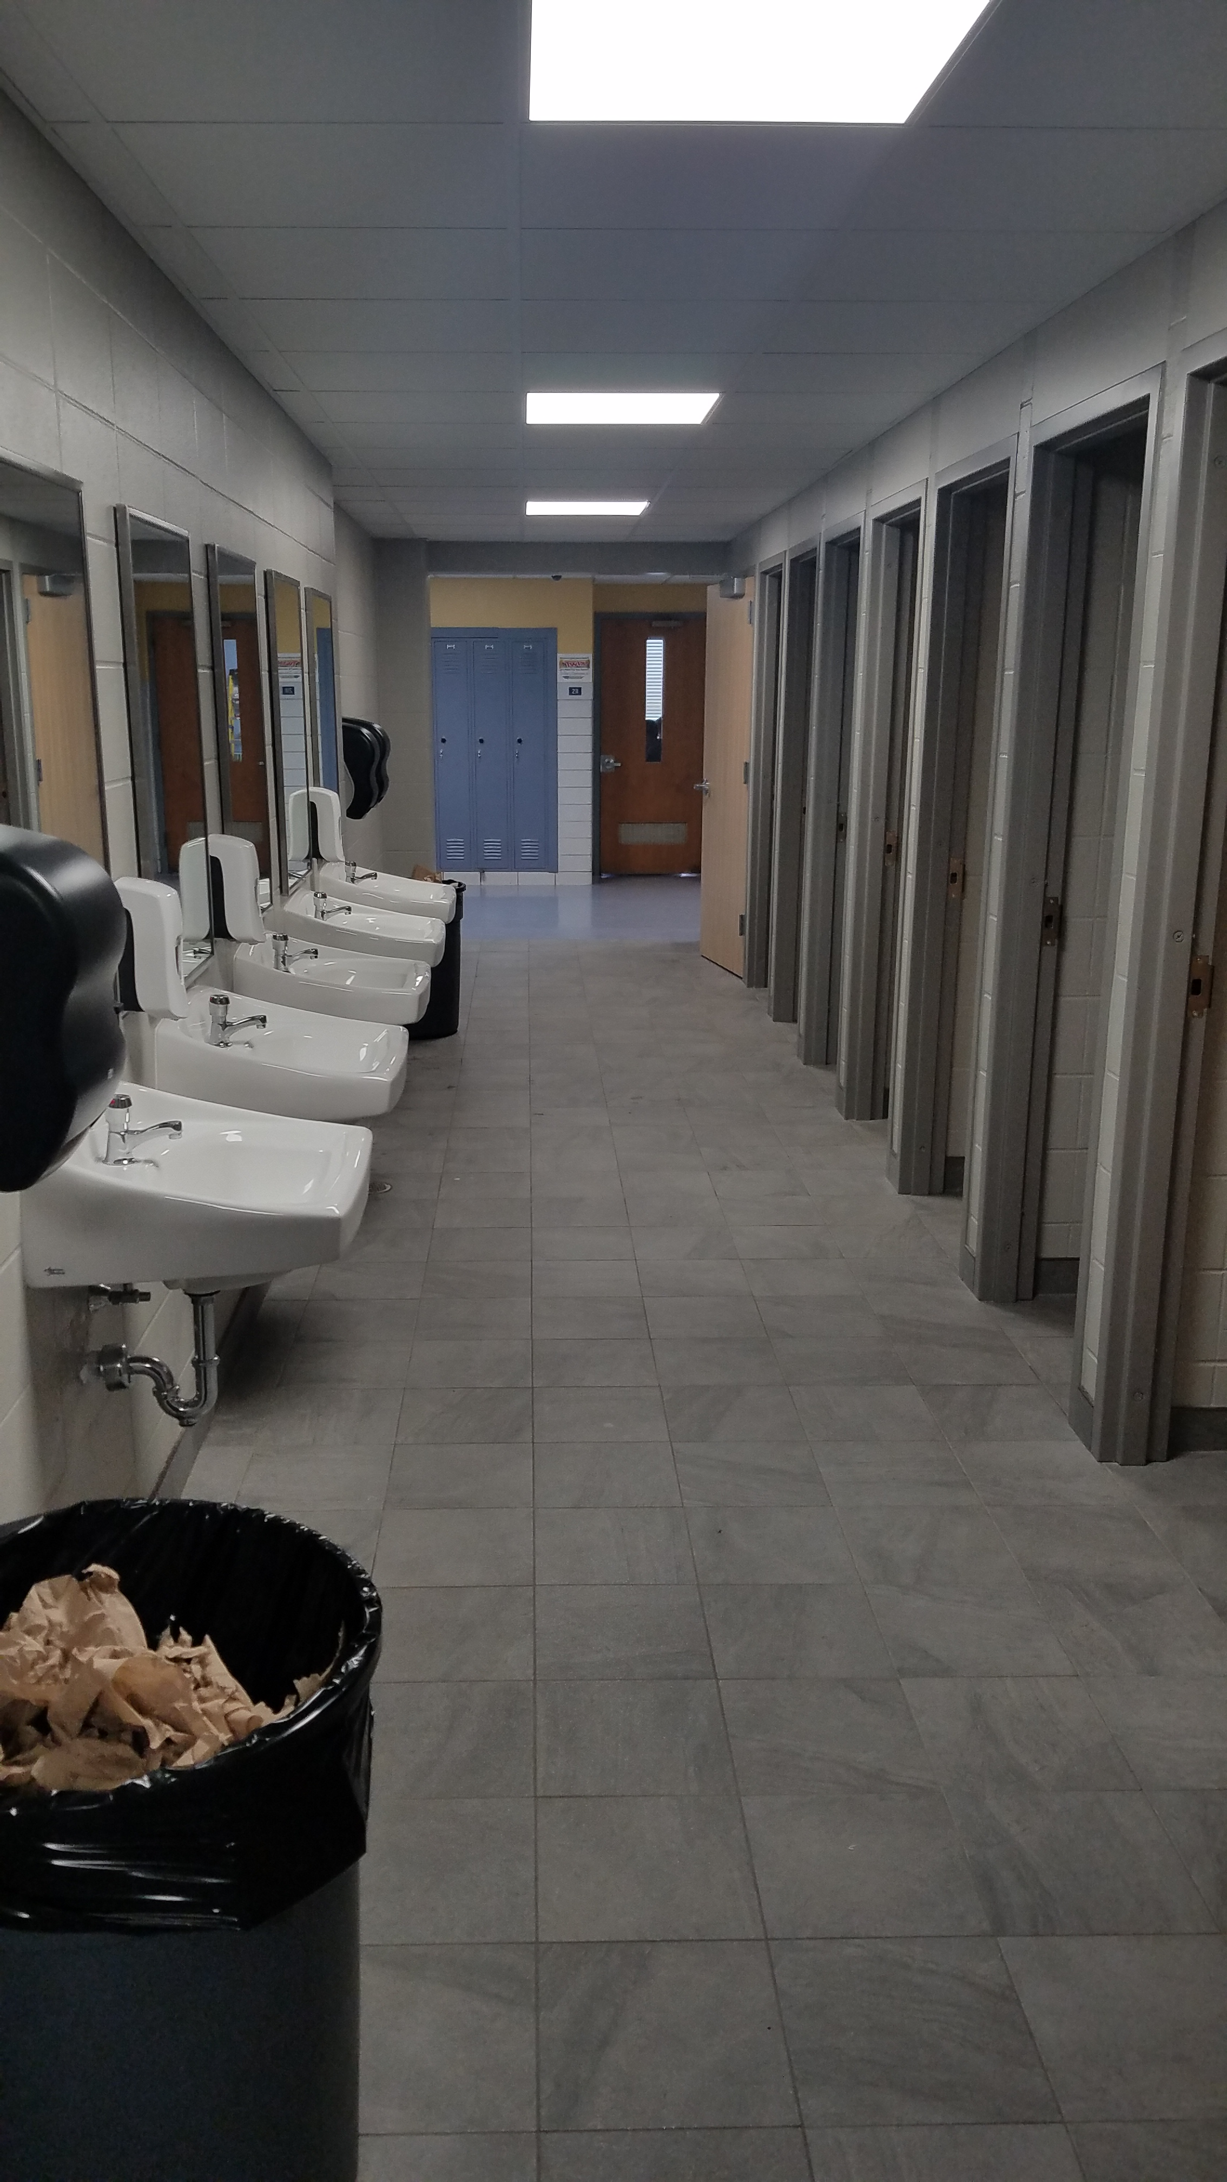
Alternative Restroom Design Ideas
Gender Neutral Toilet Area
10 compartments with only a stool
Includes ADA and Staff Stalls
each requires it’s own ventilation and fire detection components
need to coordinate doors and hardware (occupied/unoccupied)
degree of privacy – ability to monitor
addressing hygiene items
operations and maintenance – cleaning

Slide 12
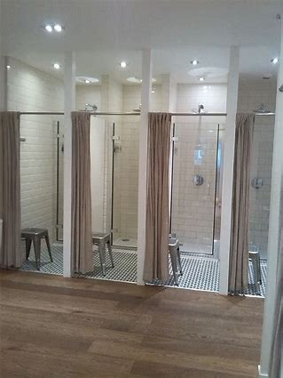
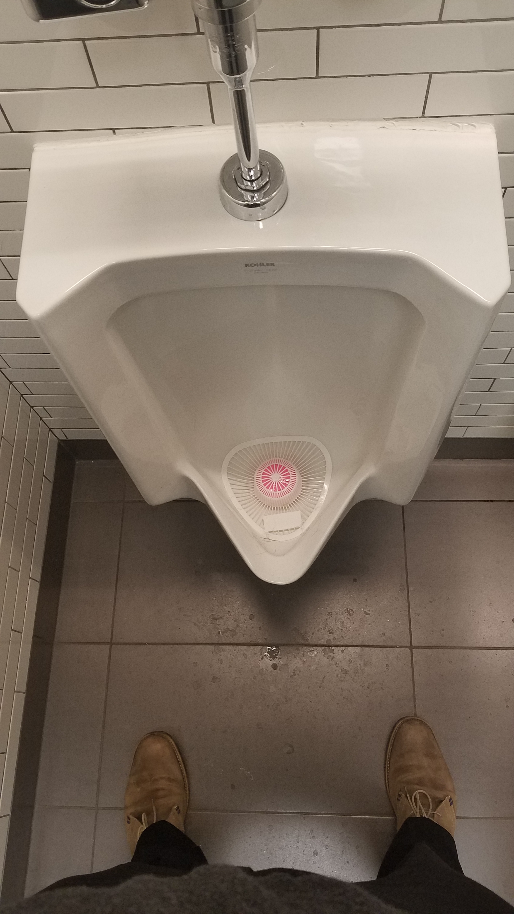
The Challenges of Good Hygiene
Locker Rooms and Other Showering/Toilet Facilities
part of participation is creating clean facilities which allow for good hygiene

Slide 13
What Are the Take A Ways?
Privacy is more that restrooms
The changing social norms and the evolving understanding of personal differences.
We need to be aware of the opportunities for bullying and other things which cause individuals discomfort
There are always impacts to operations and maintenance budgets
Always be mindful and patient with your team – ask questions
We are here to serve the public and
that means everyone

Slide 14
From the Stall
In Search of Privacy
Questions and Discussion
Kyle Fisher kyle_fisher@edenpr.k12.mn.us
Cell: 651.235.1248
Amy Satterfield amy.satterfield@ieainstitute.com
Cell: 763.229.0053
Troy W. Miller, AIA troy.miller@LHBcorp.com
Cell: 952.448.3357

